Slide 1



Indian Cargo Shipments
Limits only exists in your mind

Slide 2
Indian Cargo Shipments
A cargo ship or freighter is a that carries cargo, goods, and materials from one port to another.
Thousands of cargo carriers ply the world's seas and oceans each year, handling the bulk of international trade
A packing list is a shipping document containing an itemized detailed list of the cargo,
Including weight, dimensions, safety measures, and packaging type

Slide 3
Structured Query Language(SQL)
SQL is a standard language for accessing and manipulating databases.
SQL lets you access and manipulate databases.
SQL can set permissions on tables, procedures, and views.
The major commands (such as SELECT, UPDATE, DELETE, INSERT, WHERE) in a similar manner.

Slide 4
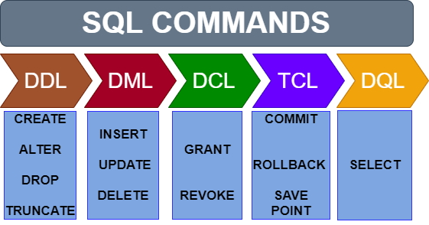
SQL OPERATIONS

Slide 5
Types of SQL Commands
Data Definition Language (DDL)
Data Manipulation Language (DML)
Data Control Language(DCL)
Transaction Control Language(TCL)
Data Query Language(DQL)

Slide 6
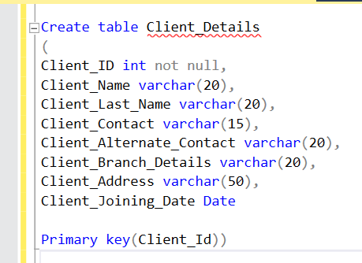
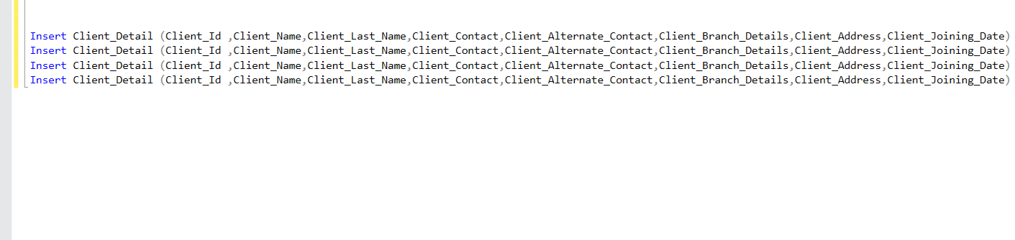
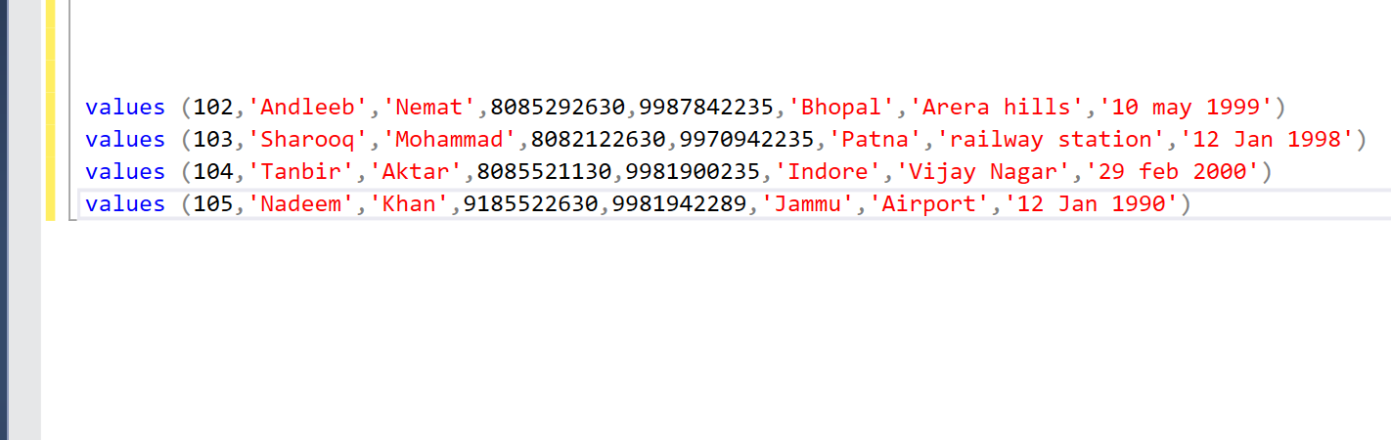
Create Table Insert Record (Create a Table by Name Client_Details) (Into Client_Details)

Slide 7
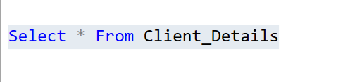
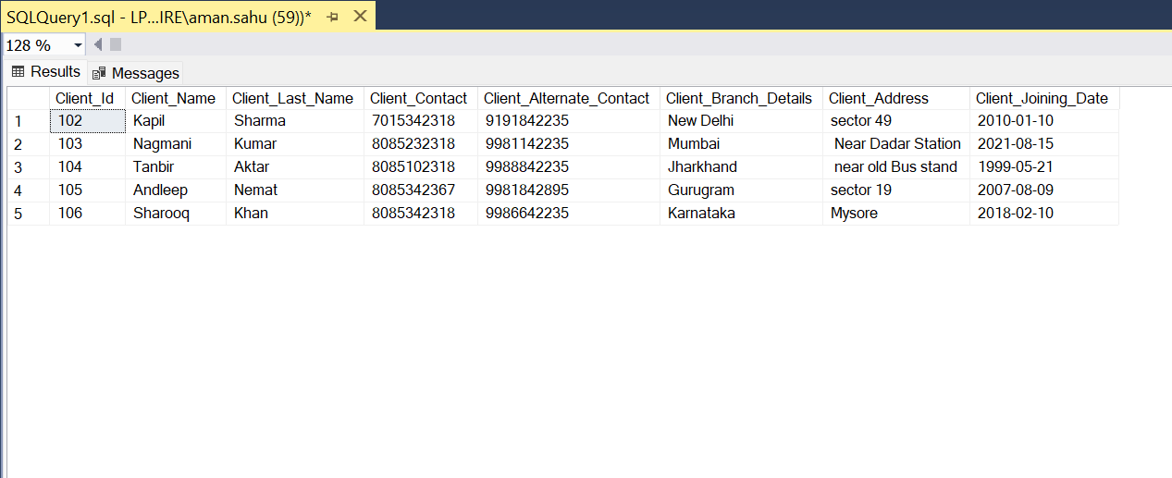
Select Command (Show All Records of Table)

Slide 8
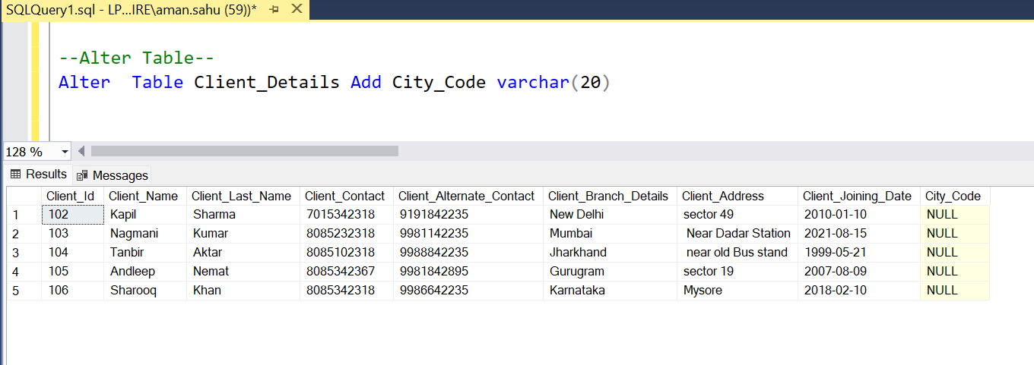
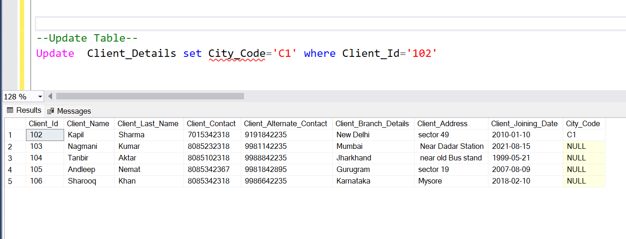
Alter & Update (Modifications on Client_Details)

Slide 9
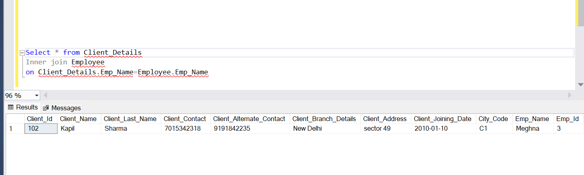
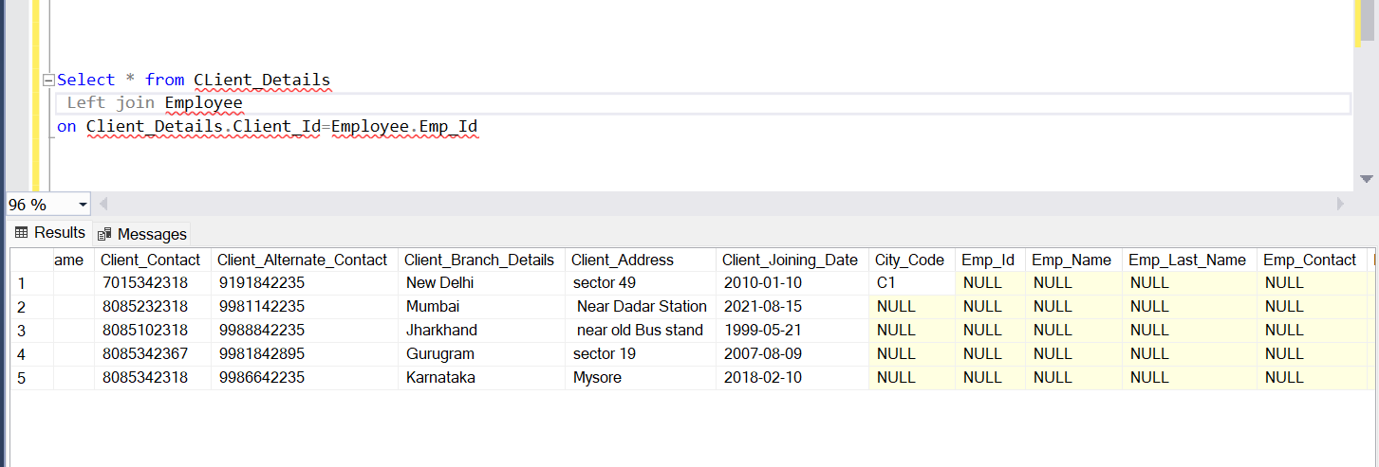
Inner Join & Left Join (Joins Apply in Client_Details)

Slide 10
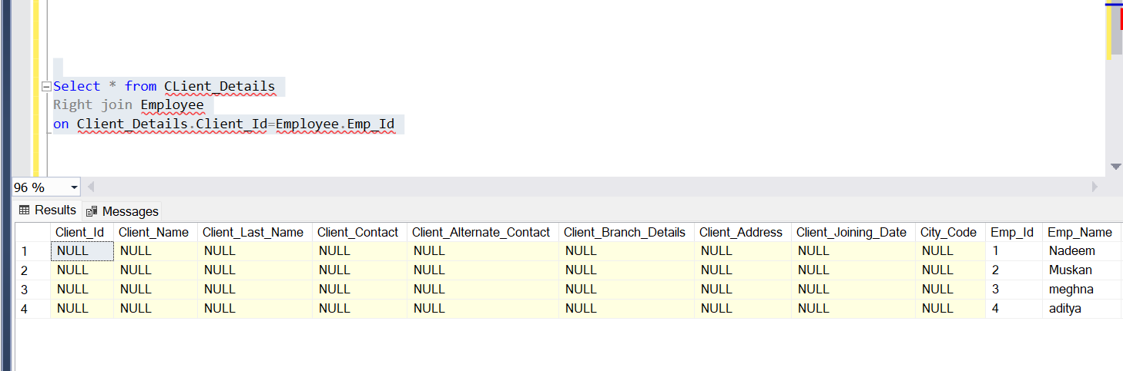
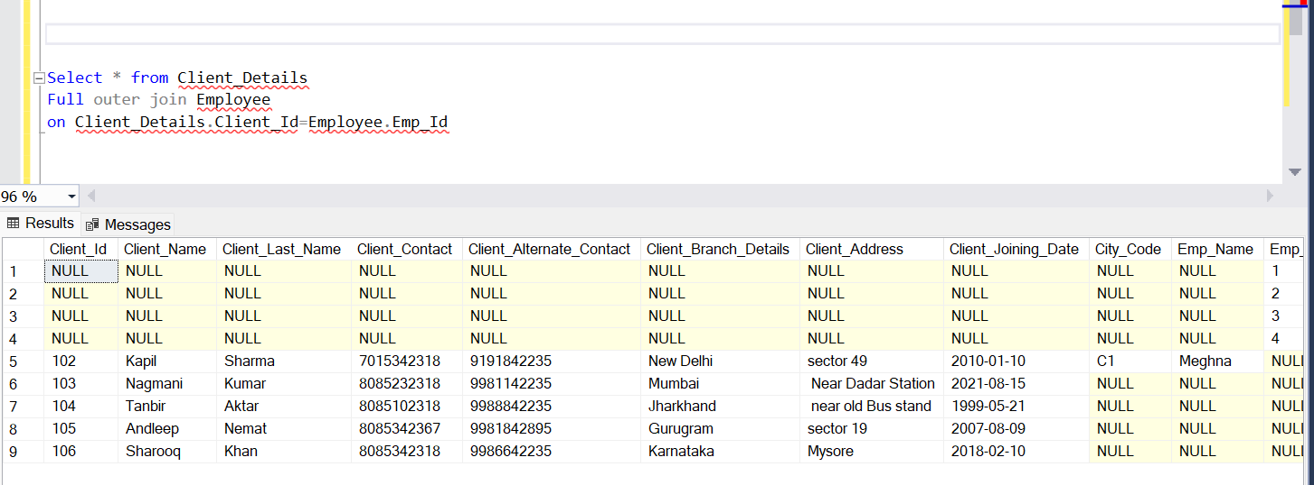
Right Join & Full Outer Join (Joins Apply in Client_Details)

Slide 11

Thank You!
Aman.sahu@espire.com

